Slide 1
Exercise 9: Using the definition of deduction, prove the following deductions

Slide 2
Propositional Formulas
The definition of deduction and the axiomatic system are used.
H1:
H2:
H3:
H4:
C: r

Slide 3
Building the deduction
f1 = H1: (hypothesis)
f2 = H2: (hypothesis)
f3 = H3: (hypothesis)
f4 = H4: (hypothesis)

Slide 4
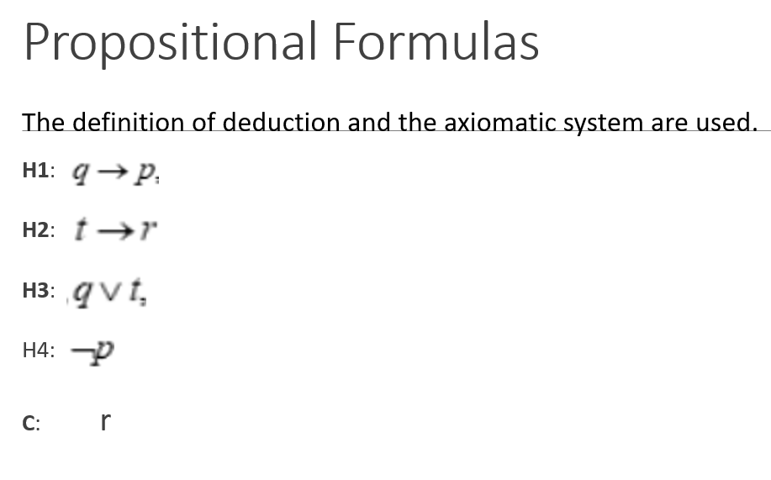
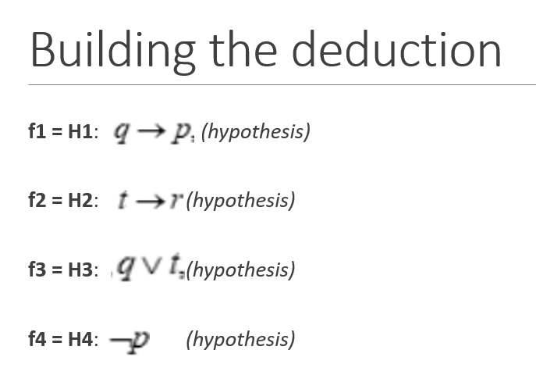
The deduction process is:
Exercise 9: Using the definition of deduction, prove the following deductions
f4,f1 |-mt -q : f5 (modus tollens is applied)
f5,f3 |-mp t : f6 (modus ponens is applied)
f6,f2 |-mp r : f7 =C (modus ponens is applied)
The sequence of formulas: (f1,f2,f3,f4,f5,f6,f7) is the deduction of C
from the hypotheses
F3=q v t -q -> t

